Slide 1
A Breakdown of State Energy Consumption across the U.S.
Group 9:
Calum Hewson, Latifah Jones, Connor Chadwick and Chad Coggins

Slide 2
How does each state compare in terms of energy usage?
What is the most prominent form of energy in the U.S., and which state uses the most of that energy form?
Which states have the highest renewable energy usage? Which states have the highest non-renewable energy usage?
How is the energy consumption distributed between sectors within each state?
How does state GDP compare to state energy usage?

Slide 3
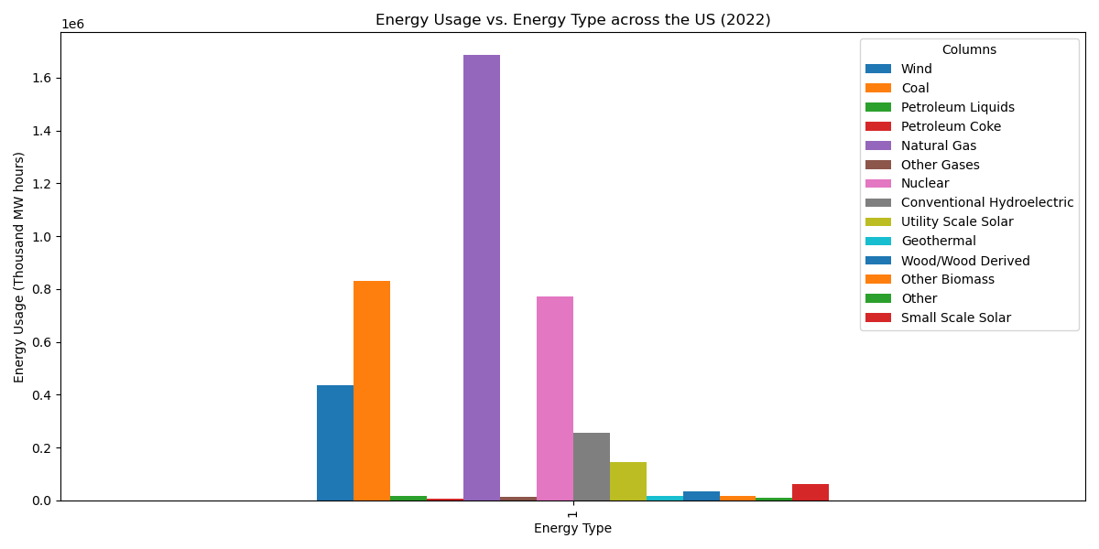
Comparing each type of energy from used in the U.S.

Slide 4
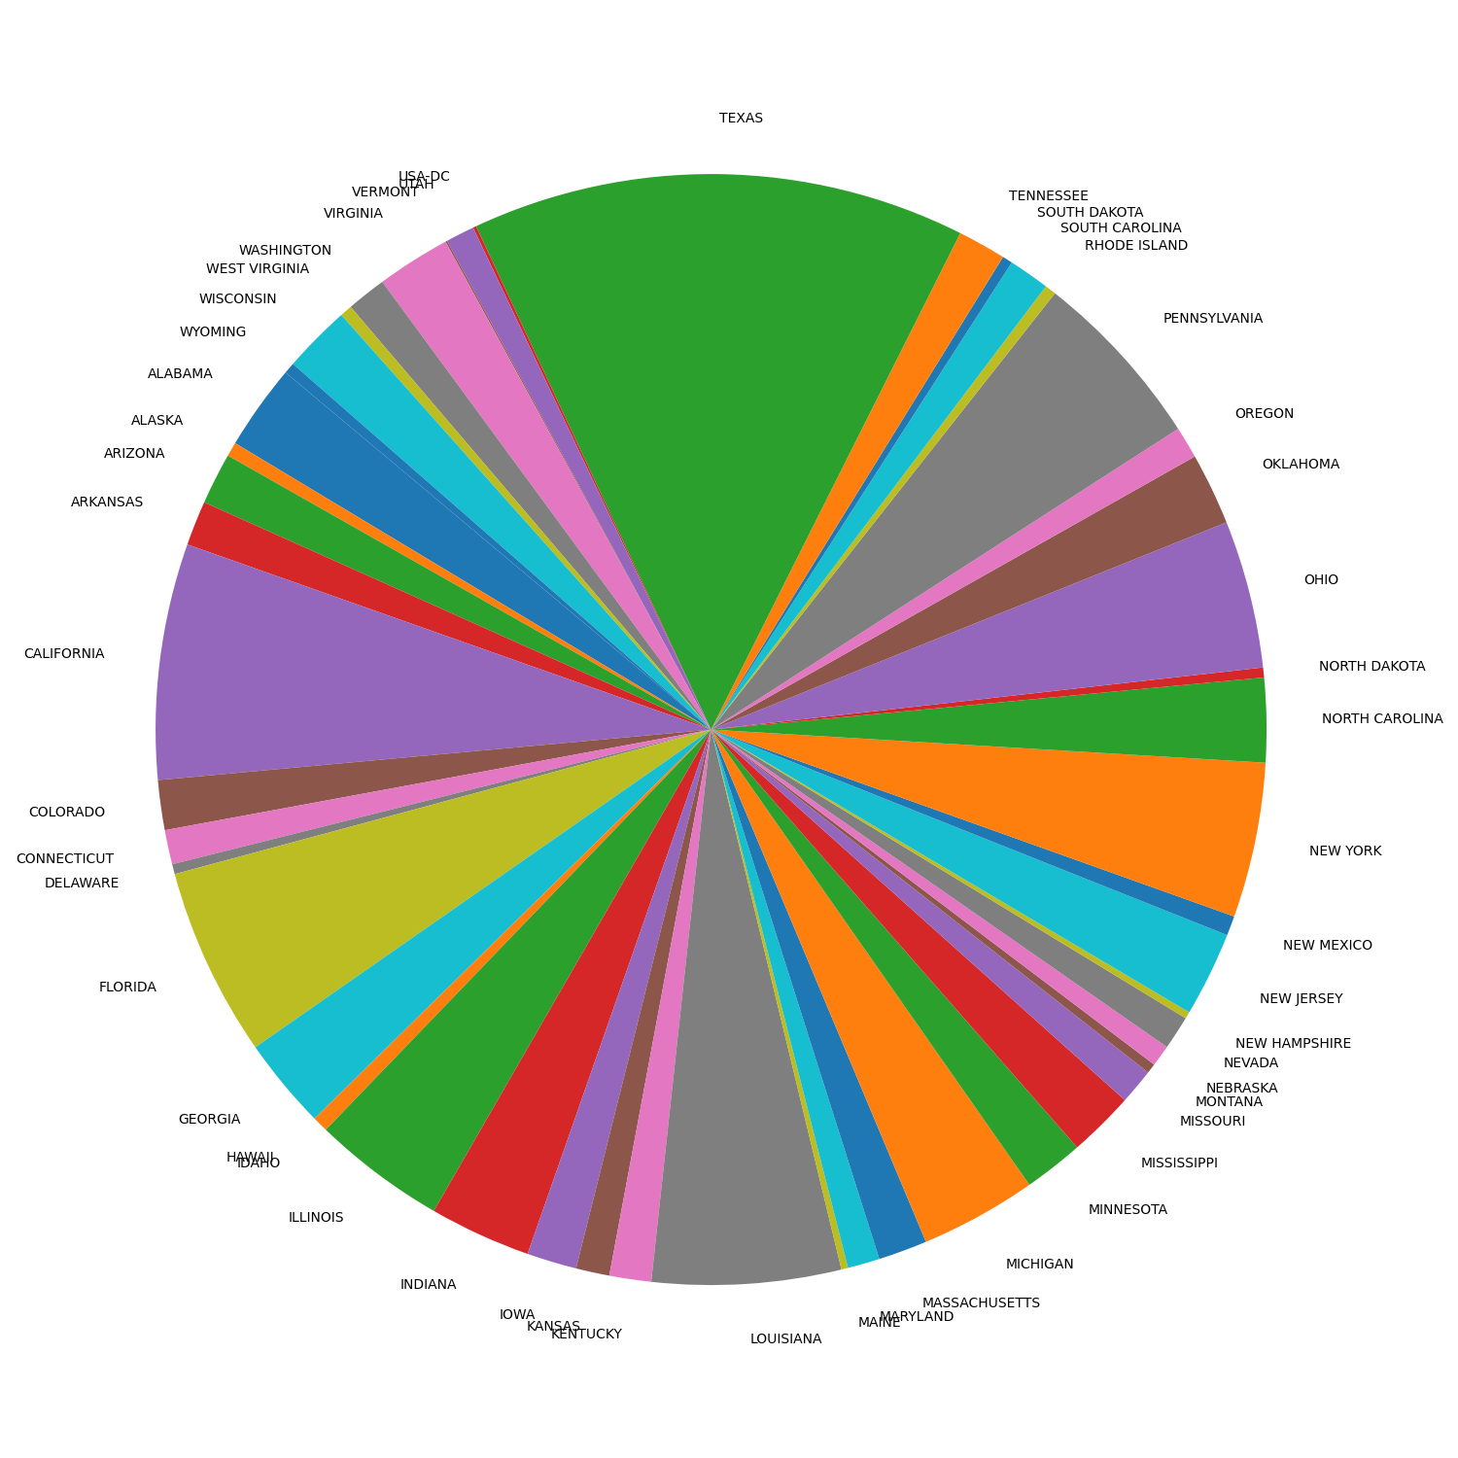
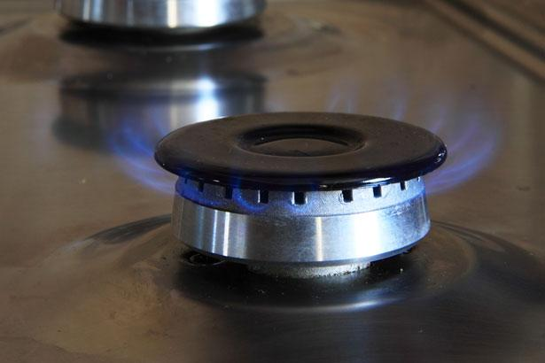
Which State has the highest natural gas consumption?

Slide 5
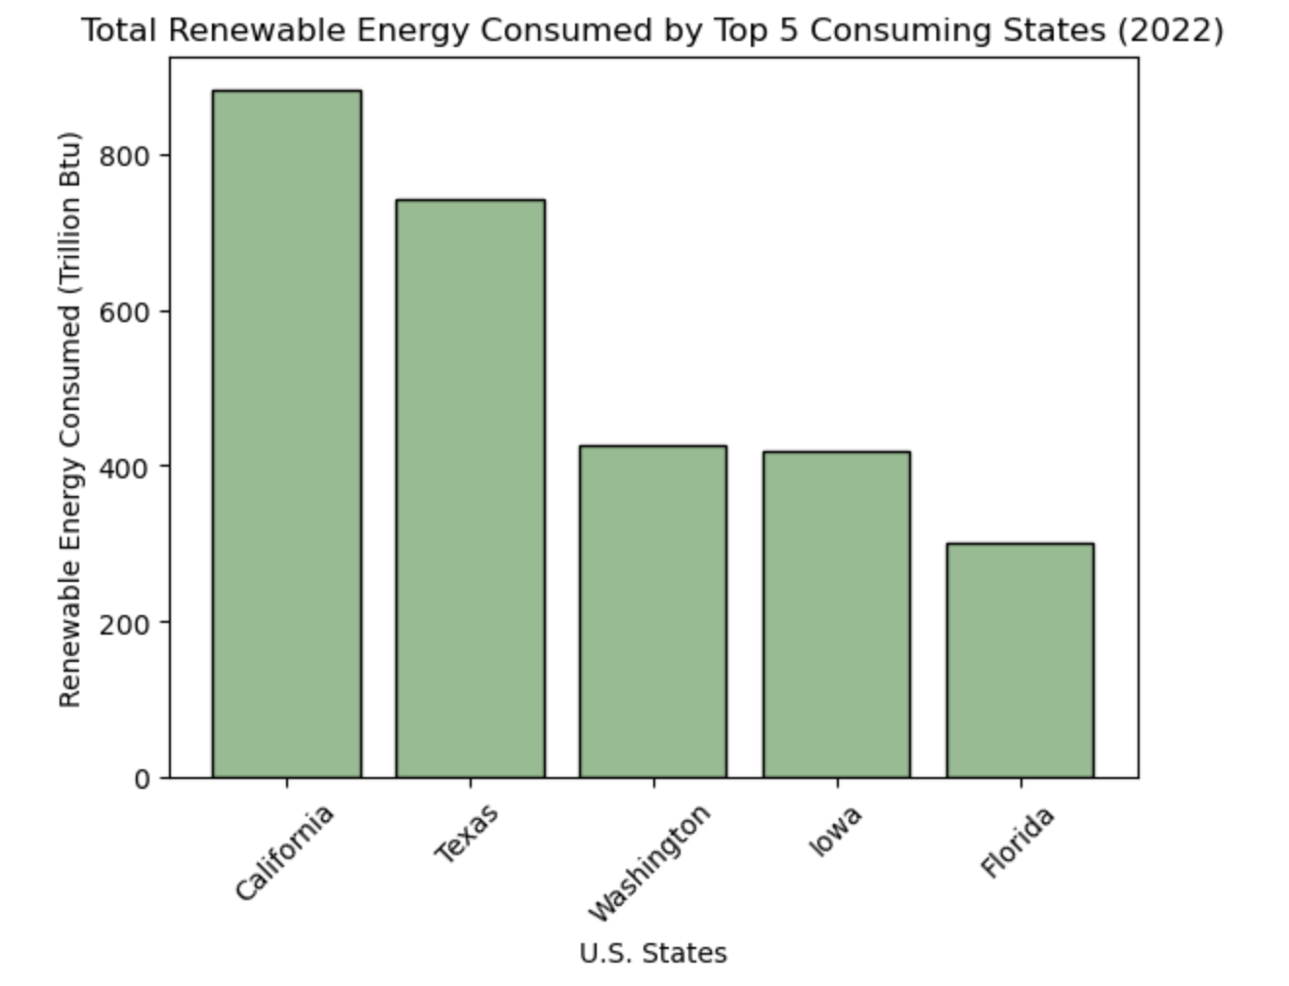
Renewable Energy Consumed by State
WA and IA overrepresented based on population
WA leads nation in hydroelectric power, accounting for ~60% of the states electricity
IA creates 62% of its total energy via wind energy, the highest percentage in the country

Slide 6
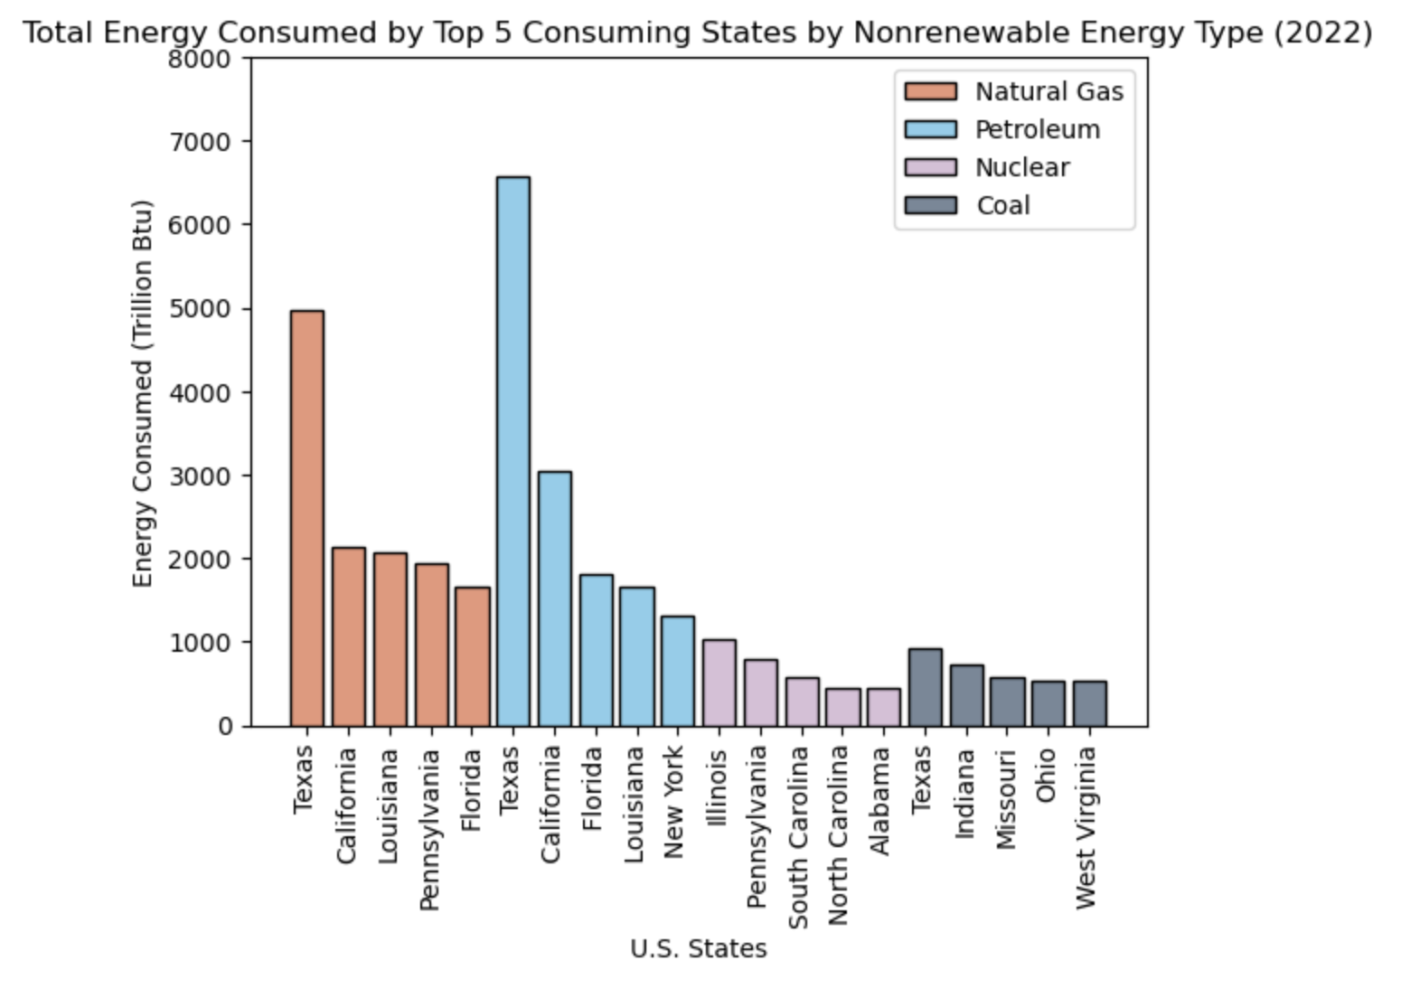
Nonrenewable Energy Consumed by State
TX and LA dominant in both Natural Gas and Petroleum consumption due to their location on Gulf Coast
Gulf Coast region responsible for ~50% of nation’s Natural Gas and Petroleum production
IL leads country in Nuclear consumption, with 50% of its energy derived from it.
State is home to 11 Nuclear reactors across 6 locations

Slide 7
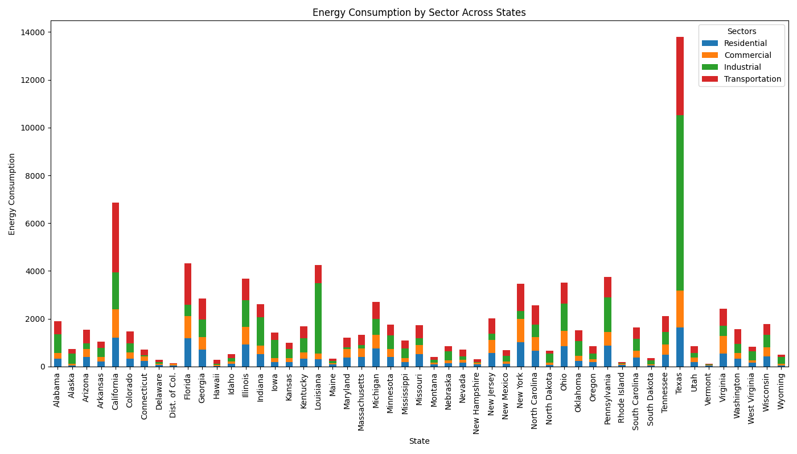
How is energy consumption distributed between sectors within each state?
Numbers shown are in Trillions btu (British Thermal Units), which is a unit of measurement for energy.
The total amount of energy consumed from all states by all sectors in 2022 was 94,773.7 Trillion btu.
Texas and Louisiana contains significantly higher energy consumption within the industrial sector compared to all other states.
California also shows a high energy consumption, particularly in the transportation and industrial sectors
Vermont, and Delaware show much lower energy consumption across all sectors, indicating lower overall demand likely due to population and industrial activity.

Slide 8
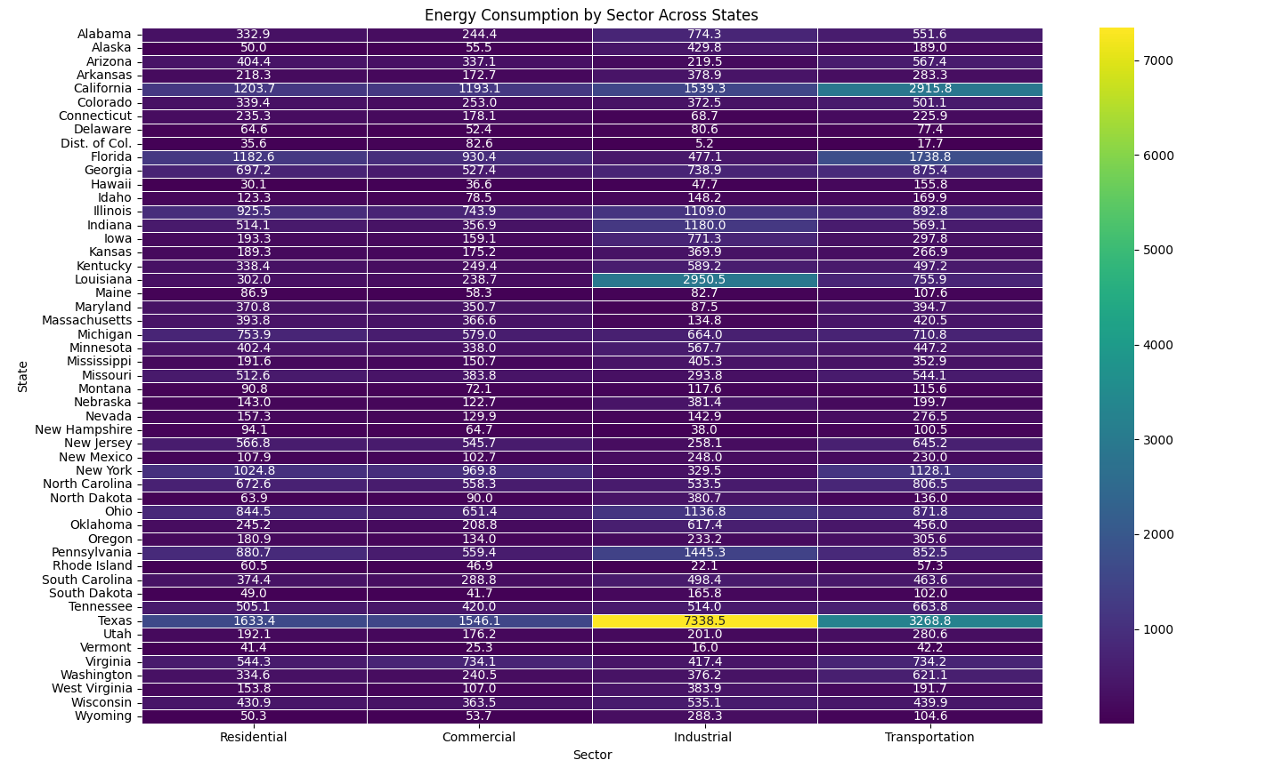
Heatmap of distribution between sectors within each state?

Slide 9
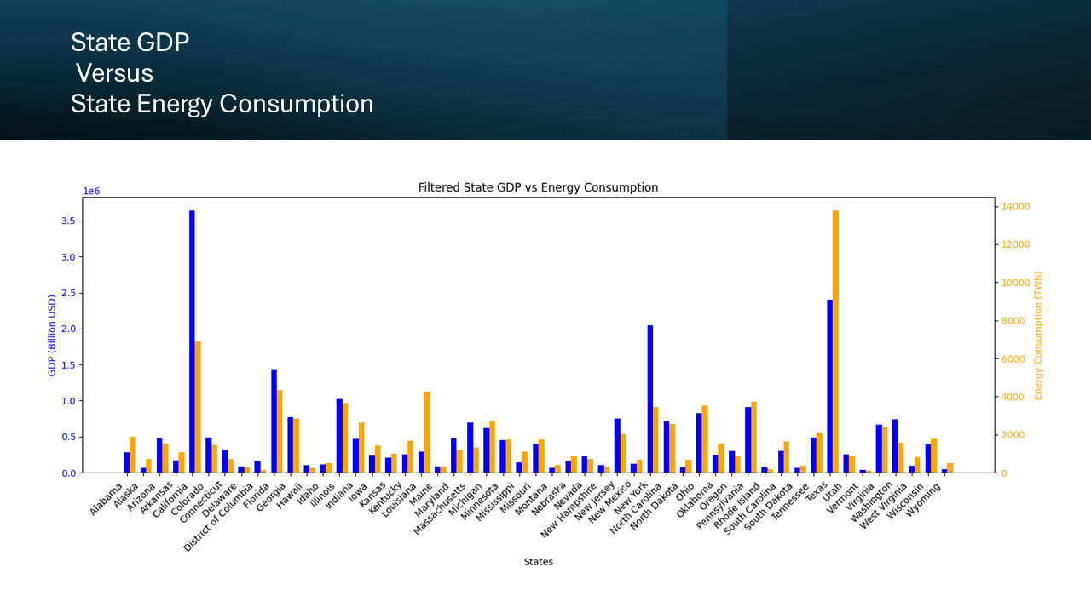

Slide 10
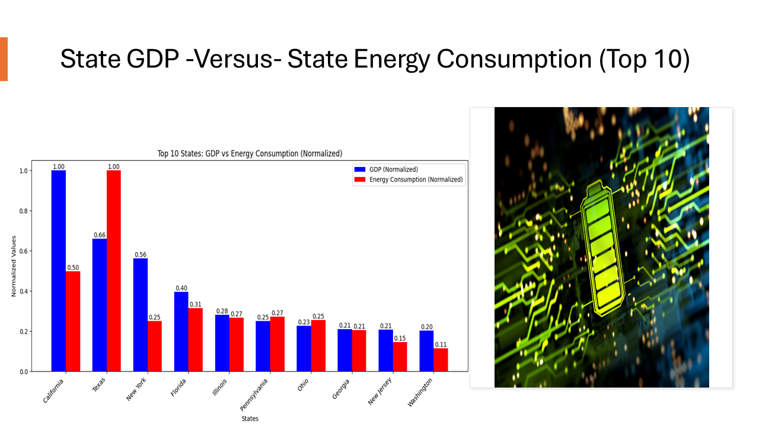

Slide 11
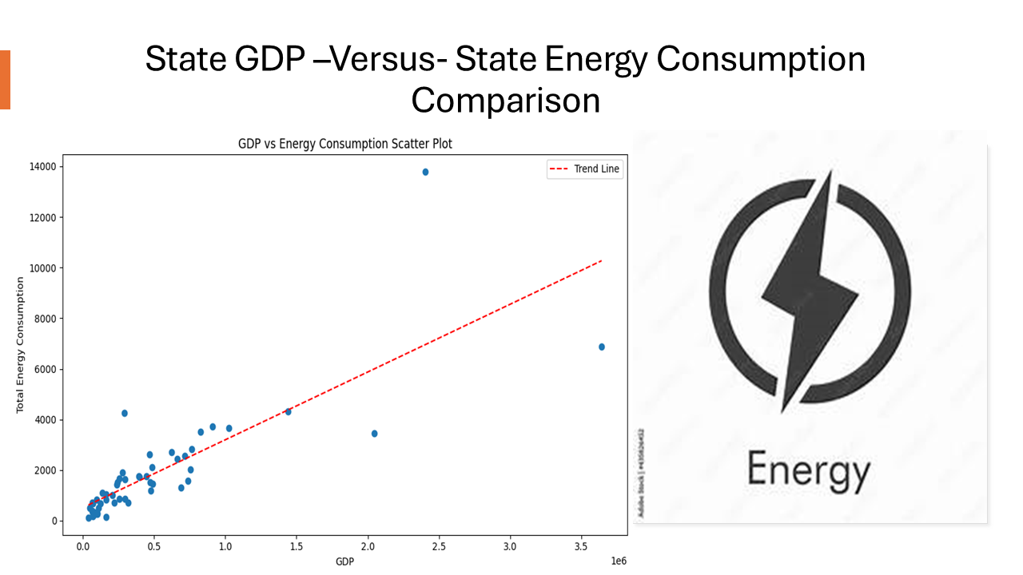

Slide 12
References
“U.S. Energy Information Administration - EIA - Independent Statistics and Analysis.” EIA, www.eia.gov/state/analysis.php?sid=IA#:~:text=In%202022%2C%2062%25%20of%20Iowa’s,all%20of%20it%20from%20wind. Accessed 5 Sept. 2024.
“U.S. Energy Information Administration - EIA - Independent Statistics and Analysis.” EIA, www.eia.gov/state/analysis.php?sid=WA. Accessed 5 Sept. 2024.
“U.S. Energy Information Administration - EIA - Independent Statistics and Analysis.” EIA, www.eia.gov/special/gulf_of_mexico/#:~:text=Over%2048%25%20of%20total%20U.S.,natural%20gas%20processing%20plant%20capacity. Accessed 5 Sept. 2024.
Nuclear Power in Illinois, iemaohs.illinois.gov/content/dam/soi/en/web/iemaohs/nrs/documents/bnfs-powerplantbrochure.pdf. Accessed 6 Sept. 2024.

